Slide 1
Structures for Implementation
Notes:
The way in which this NC K-3 Formative Assessment Process will be implemented during the usability study is a bit different from the way implementation may have occurred in the past (e.g., train-the-trainer). Using the most recent research about effectively scaling up statewide initiatives so that they are sustainable and successful, NCDPI is partnering with District Implementation Teams to begin putting in place components that will support implementation of the NC K-3 Formative Assessment Process as well as future district/statewide initiatives.

Slide 2
Why Focus on Implementation?
Implementation is defined as a specified set of activities designed to put into practice an activity or program of known dimensions.
IMPLEMENTATION
RESEARCH
GAP
PRACTICE
Why Focus on Implementation?
Students cannot benefit from interventions they do not experience.
Notes:
Over the past several decades, considerable research, policy and funding have been focused on the development and use of evidence-based programs and practices including formative assessment. However, formative assessment is only effective when fully implemented in the classroom. We often see in classrooms where certain aspects of the formative assessment process have been implemented, such as the use of exit tickets and the posting of learning goals on the board, but the research supports the use of all components of the process to experience the gains in student learning that we hope to see.
Despite the promising outcomes that these research-based practices can impact, there needs to be additional effort put into fully implementing them. This produces a gap between the research behind the practices and their successful implementation in the classroom. This has caused a gap that needs to be bridged by putting more emphasis on implementation. Why put our focus here? Because students cannot benefit from practices that do not occur in the classroom.

Slide 3
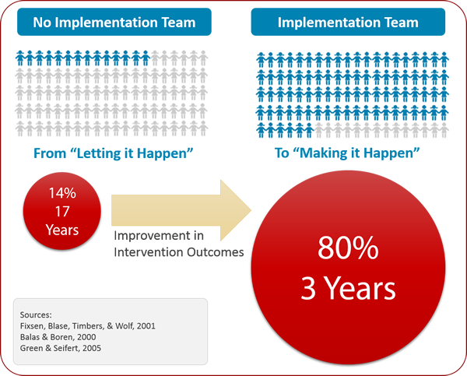
Implementation Teams
Notes:
Implementation Teams have been called a new lever for organization change in education (Higgins, Weiner, & Young, 2012)
Research has shown that, without the use of implementation teams that keep a focus on implementation infrastructures, it takes an average of 17 years to achieve full implementation in only14% of sites. However, with the support of implementation teams, we can reach full implementation in 80% of sites, in only 3 years. And that difference of 14 years is the full career of a generation of students!

Slide 4
Linked Team Structures
State
Implementation Design Team
Implementation Teams
Regional
Implementation Team
District
Implementation Team
Building
Implementation Team
Notes:
To support the implementation of the NC K-3 Formative Assessment Process, the Office of Early Learning has created two structures: the State Implementation Design Team, which plans for and supports Regional Implementation Teams.
NCDPI has asked districts to form District-level Implementation Teams. NCDPI’s Regional Implementation Team supports our District’s Implementation Team through monthly planning meetings and regular communication.
Our District Implementation Team is supporting each school participating in the Usability Study to form a Building Implementation Team. (NOTE: You may wish to include a slide that provides the names and contact information of your District Implementation Team members).
Regular between each level of the system (represented by the arrows), school, district, regional and state, is key in order to quickly address potential barriers to implementation and to share successful implementation practices across a district or between districts.

Slide 5
Supporting Teachers
Discovery Education's Clip Art Gallery created by Mark A. Hicks, illustrator
Notes:
Supported by NCDPI Implementation Teams by way of coaching and technical assistance, District Implementation Teams will support the scale-up of the NC K-3 Formative Assessment Process by:
Analyzing data for implementation support and sustainability
Supporting Building Implementation Teams as they drive implementation in their schools
Support educators in the use of digital tools to help gather and organize evidence of learning
Providing resources and professional development regarding collecting evidence of learning, using the evidence collected to map where children are on the progression and deciding what instructional steps come next.
Providing resources, tools, and professional development regarding effective use of formative assessment in the classroom
Identifying resources that will help teachers align instruction with the NC Standard Course of Study.

