Slide 1
NC K-3 Formative Assessment Process: The Vision
Notes:
Let’s explore the vision of the NC K-3 Formative Assessment Process.

Slide 2
Notes:
The NC K-3 Formative Assessment Process was developed in accordance with a solid research base and in response to ideas of expert teachers of young children across the state of North Carolina. Research supports positive interactions between teachers and students, instruction that focuses on all aspects of child development, and multiple approaches to teaching—together forming the foundation of a formative assessment process. North Carolina teachers informed us that they are eager to balance summative and benchmark assessments with a process that 1) gives them a more complete picture of a child’s developing abilities, 2) can be integrated into daily instruction, and 3) is manageable and meaningful. This combination of research and professional wisdom provides the best opportunity for children to demonstrate what they know and are able to do, and to help each child reach challenging and achievable goals that contribute to his/her ongoing development and learning.

Slide 3
NC K-3 Formative Assessment Process
A process used by teachers and students during instruction that provides feedback to adjust ongoing teaching and learning to help students improve their achievement of intended instructional outcomes.
CCSSO 2006
AERA, APA, NCME, 2014
Notes:
The NC K-3 Formative Assessment Process is based on the NCDPI adopted definition (2006) of formative assessment: a process used by teachers and students during instruction that provides feedback to adjust ongoing teaching and learning to help students improve their achievement of intended instructional outcomes. Recently (2014), this definition was also adopted by AERA (American Education Research Association), APA (American Psychological Association), and NCME (National Council on Measurement in Education).
The NC Department of Public Instruction recognizes formative assessment as an important component of 21st Century Balanced Assessment System and has dedicated materials resources to support its use in NC schools. For more information about NCDPI and the Balanced Assessment System, please visit: ncpublicschools.org/accountability/educators/vision

Slide 4
NC K-3 Formative Assessment Process
Third Grade
Second Grade
First Grade
Kindergarten
KEA
Notes:
The NC K-3 Formative Assessment Process provides tools for teachers to use to implement the process of formative assessment throughout the school year for Kindergarten, First, Second, and Third Grades. During this process, teachers elicit evidence of learning from families, PreK teachers, other building educators, as well as during classroom observations, conversations, work samples and activities facilitated by teachers. Teachers use this variety of evidence to plan daily instruction and support children’s growth and development.
Notice that the boundaries between the different grades are blurred on this diagram. This is because there isn’t a “First Grade Assessment” or a “Third Grade Assessment”. Rather, the NC K-3 Formative Assessment Process was developed to support growth and development of children, ages 3 to 10. Therefore, a teacher can tailor the tools provided based on the students’ current development and understanding.
Also, notice the dark purple circle within the Kindergarten section of the diagram. A portion of this NC K-3 Formative Assessment Process includes a “Kindergarten Entry Assessment”. While teachers collect evidences throughout the year to inform teaching and learning, only summary status data after the 60th day of Kindergarten is entered into the state's longitudinal data system.

Slide 5
NC K-3 Formative Assessment Process: Vision
4 Key Points
Notes:
Let’s look at 4 Key Points about the NC K-3 Formative Assessment Process Vision.

Slide 6
KEY POINT 1
K-3 Formative Assessment Process focuses on the whole child: 5 Domains of Learning and Development
Notes:
The K-3 Formative Assessment Process focuses on the whole child. This means that it addresses five domains of learning and development. Research clearly indicates the importance of attending to and supporting children’s growth and development in all of these areas especially since children’s development in one area impacts their development in other areas. . For example, if a child does not feel well, he or she may not approach a new task with vigor and interest or remember the two-step directions that were given. Therefore, when we think about and plan for children’s learning and development, we need to consider the whole child.
Many of our NC Standards fall within these domains. For example, Math, Science, Social Studies and the Arts fall within the Cognitive Development Domain.

Slide 7
K-3 Formative Assessment Process
Domain | Constructs
Approaches to Learning | Engagement in Self-Selected Activities Perseverance in Assigned Activities
Cognitive Development | Object Counting Problem Solving
Emotional-Social Development | Emotional Literacy Emotion Regulation
Health & Physical Development | Fine Motor Development Gross Motor Development Midline Motor Development
Language Development & Communication | Book Orientation & Print Awareness Following Directions Letter Naming Reading Comprehension: Monitoring Meaning School-Related Vocabulary Writing
Notes:
While there are many aspects of each of the 5 domains that are important to student success, the NC Think Tank and the NC Assessment Design Team carefully selected these constructs, or concepts, within each domain to focus on within this formative process. The team based these decisions on various aspects including what research identified to be most critical for long term student success, what K-3 teachers found to be important, and alignment to the NCSCOS.
NOTE: This list identifies current constructs. Based on feedback from the field and other factors such as NC SCOS revisions, these constructs and the assessment tools to support this process will be revisited and enhanced over time.

Slide 8
KEY POINT 2
The NC K-3 Formative Assessment Process during instruction rather than as an isolated event apart from instruction.
This embedded formative process is comprised of 5 Critical Components.
Notes:
The NC K-3 Formative Assessment Process was developed in accordance to the definition of formative assessment, as adopted by NCDPI: Formative Assessment is a process used by teachers and students during instruction that provides feedback to adjust ongoing teaching and learning to help students improve their achievement of intended instructional outcomes. AERA/APA/NCME, 2014; CCSSO, 2006
In contrast to summative assessment, formative assessment occurs in an ongoing manner during—rather than separate from or at the end of—instruction. Evidence gathered helps teachers identify where students are currently in their learning and informs next steps with instruction. Thus, the NC K-3 Formative Assessment is a cyclical process that occurs daily rather than a test that is administered at one point in time.
The Implementation Design Team identified 5 Critical Components of the K-3 Formative Assessment Process and has clearly defined the implementation of each critical component in the classroom.

Slide 9
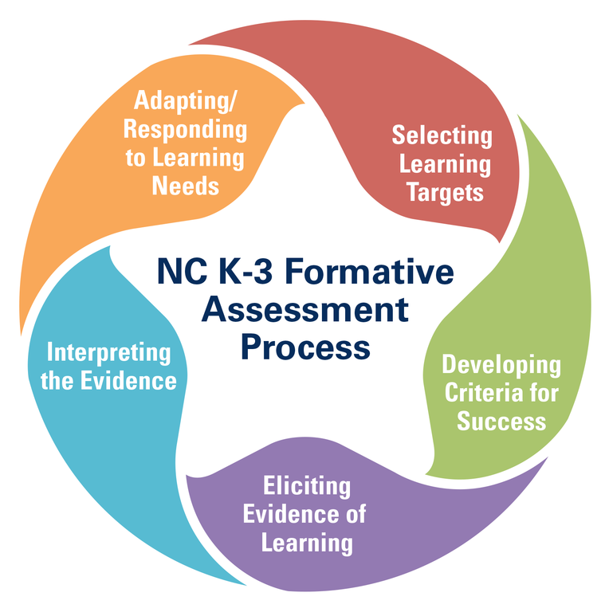
KEY POINT 2
The 5 Critical Components
Selecting Learning Targets
Developing Criteria for Success
Eliciting Evidences of Learning
Interpreting the Evidence
Adapting/Responding to Learning Needs
Notes:
The 5 Critical Components of the NC K-3 Formative Assessment Process are:
Selecting Learning Targets: The teacher uses what the student currently knows (learning status) and engages students in the identification of the next understanding/skill to learn (learning target)
Developing Criteria for Success: The teacher identifies what it will look like when the student has learned the identified understanding/skill
Eliciting Evidence of Learning: The teacher learns what the students know and are able to do and captures that evidence in a variety of ways (e.g., observation-based notes, video recordings, work samples)
Interpreting the Evidence: The teacher interprets the evidence elicited and identifies the students’ current learning status
Adapting/Responding to Learning Needs: The teacher makes quick adjustments to instruction based on the interpretation of evidence in the moment and/or within a series of lessons. In addition, the teacher provides descriptive feedback to students that is not graded or evaluative and aligns with the criteria for success.

Slide 10
KEY POINT 2
There are a variety of ways to learn about students during instruction
observe students working
ask probing questions
listen to student thinking
review student work
Notes:
Throughout the day, the teacher facilitates learning experiences. While children are working on assigned activities by the teacher and self-selected activities chosen by the students, the teacher is able to learn about the students by what they make, do, say or write. Therefore, teachers learn about their students by eliciting evidences of student learning by observing, asking probing questions, listening to what children are saying, and examining student work. This occurs as the teacher is teaching and the student is learning.

Slide 11
KEY POINT 2
Teachers can learn about students throughout the day in a variety of settings
whole group
small group
centers/stations
pairs
individual
Notes:
When a classroom schedule allows for a variety of groupings (whole, small, centers, stations, individual), the teacher elicits evidences of student learning in a variety of contexts. In addition, the students are able to learn, practice, and further develop skills and understandings in a variety of settings.

Slide 12
KEY POINT 3
Teachers can collect evidence about students using a variety of strategies:
talk with families
take photos/videos
record student conversations
write anecdotal notes
collect work samples
incorporate evidence from other school educators (e.g., PE, OT, Speech, ELL)
Notes:
Multiple strategies can be used to capture student understanding- both those we are already using and new methods. Evidences of student learning can be captured quickly, stored securely on the electronic platform for easy referral, and used to document learning and plan instruction.
Parents may choose whether or not photographs and videos of their child are collected and stored as evidence on the electronic platform.

Slide 13
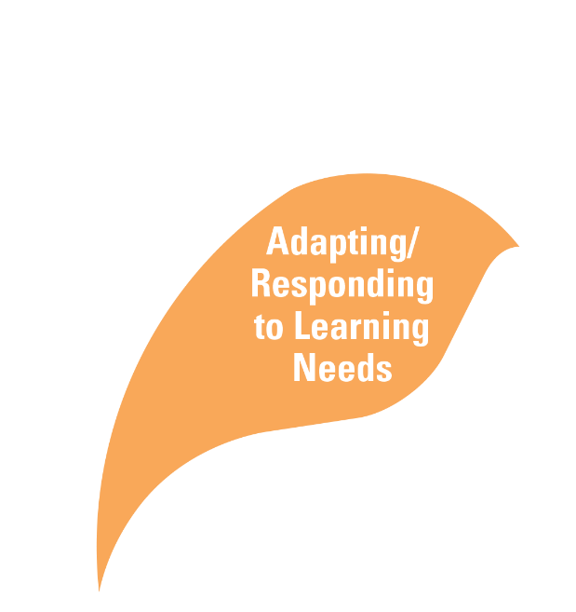
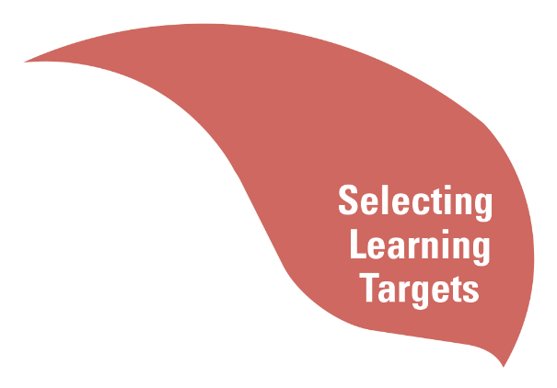
KEY POINT 4
Evidence is used to guide instruction and learning:
identifies what students know and are able to do and where to head next
helps to plan and adjust instruction in an ongoing manner
helps to meet the needs of all students
Notes:
Teachers use a variety of data to better understand what their students know and are able to do (Interpret the Evidence). Based on this evidence, the teacher plans and adjusts instruction (Adapting/Responding to Learning Needs) by determining where to head next (Learning Target) and clearly identifying what it looks like when a child demonstrates the skill (Criteria for Success); thus, supporting the teachers’ efforts to meet the needs of the students.

Slide 14
Summary
Formative Assessment Process
Comprised of 5 Critical Components
Focuses on the Whole Child
Evidence is elicited in a variety of ways & settings
Evidence is used to adapt and respond to the learning needs
Notes:
The NC K-3 Formative Assessment Process occurs daily during instruction. As teachers listen & observe carefully to what their students know and understand, teachers and students are able to make decisions about the next steps in students learning. The NC K-3 Formative Assessment Process helps teachers and families continuously identify each child’s varying strengths and needs in an effort to ensure that every child reaches his or her fullest potential.

