Slide 1
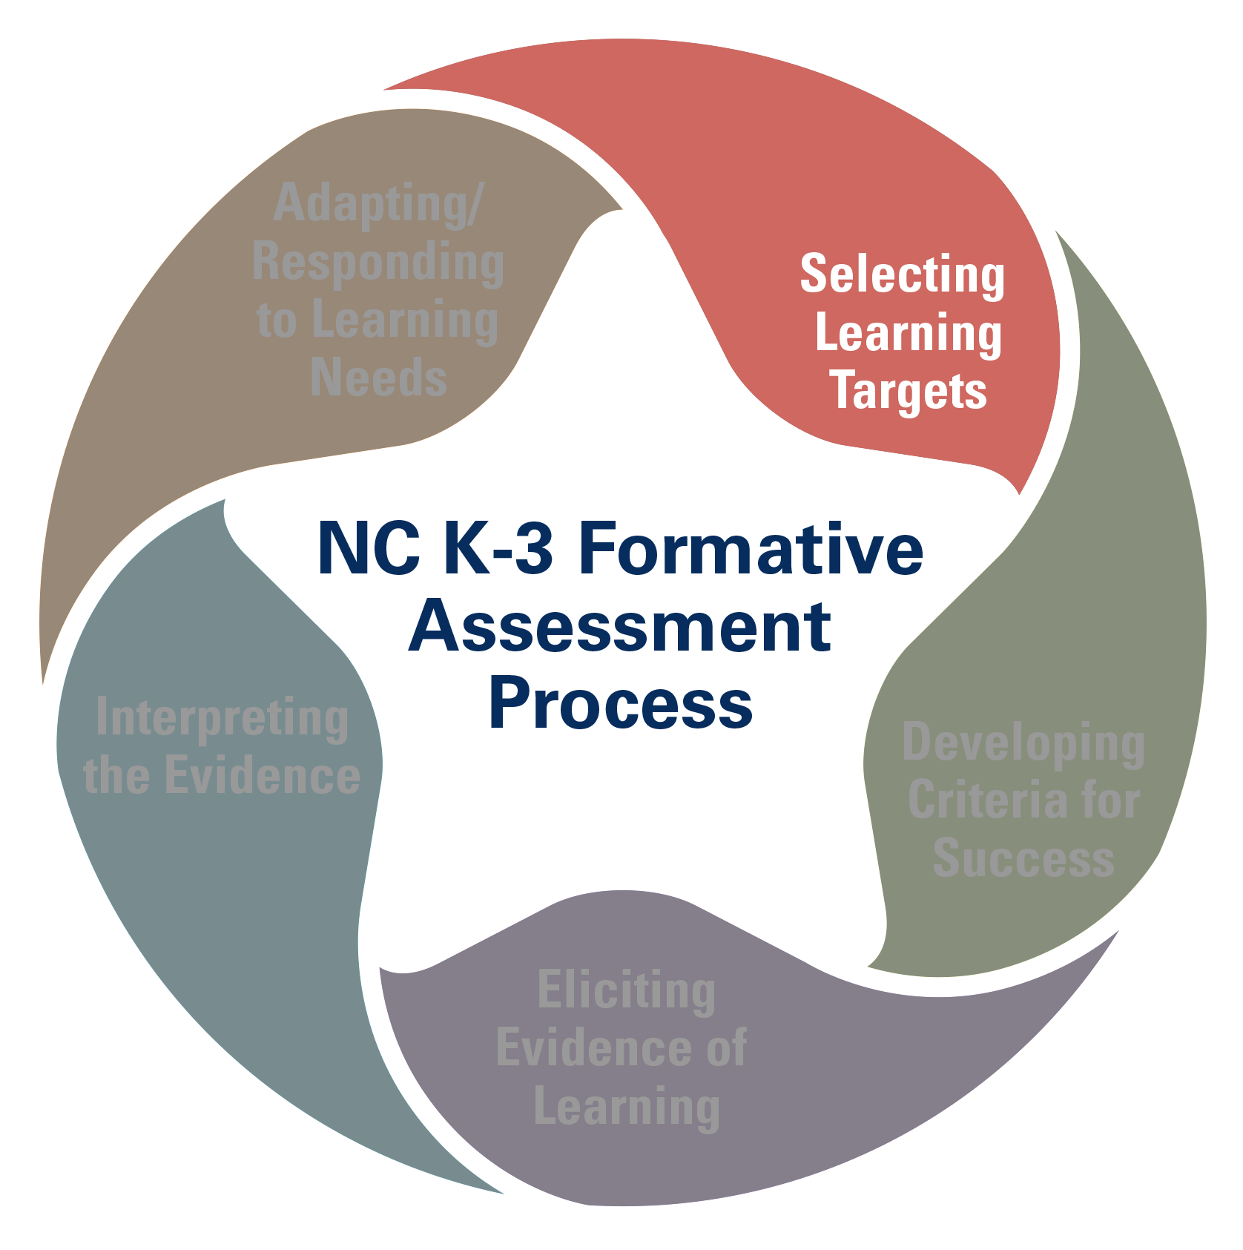
5 Domains of Learning & Development

Slide 2
KEY POINT
The K-3 Formative Assessment Process focuses on the whole child.

Slide 3
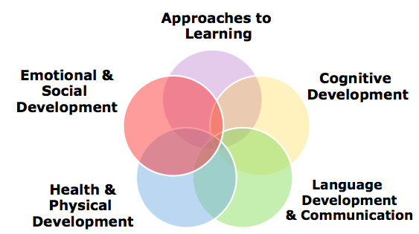
5 Domains of Learning & Development
Notes:
The K-3 Formative Assessment Process focuses on the whole child. This means that it addresses five domains of learning and development. Research clearly indicates the importance of attending to and supporting children’s growth and development in all of these areas especially since children’s development in one area impacts their development in other areas. . For example, if a child does not feel well, he or she may not approach a new task with vigor and interest or remember the two-step directions that were given. Therefore, when we think about and plan for children’s learning and development, we need to consider the whole child.
Many of our NC Standards fall within these domains. For example, Math, Science, Social Studies and the Arts fall within the Cognitive Development Domain.

Slide 4
5 Domains of Learning & Development
Approaches to Learning Definition
Focuses on how children learn and includes children’s attitudes toward and interest in learning.
Curiosity
Planning
Flexibility
Motivation
Focus
Problem-solving
Persistence
Approaches to Learning
Emotional &
Social Development
Cognitive Development
Health &
Physical Development
Language Development
& Communication
Notes:
Approaches to Learning addresses how children learn and includes children’s attitudes toward and interest in learning. It reflects behaviors and skills such as curiosity, planning, flexibility, motivation, focus, problem-solving, and persistence. Children show these characteristics in the way they learn in all the domains and curriculum areas.
The skills, capacities, behaviors, and tendencies that compose a student’s approach to learning are critical to success in school. New research indicates that these characteristics are not fixed when a child enters kindergarten; they are built through quality instruction and shaped by a student’s daily experiences in and out of school.

Slide 5
5 Domains of Learning & Development
Approaches to Learning Think Tank Claims
Students can effectively solve problems by defining goals, describing steps, and evaluating alternative strategies in both academic and social interactions.
Students can maintain focus and persevere to accomplish collaborative and individual tasks whether those tasks are chosen by them, or assigned to them.
Students can demonstrate curiosity by seeking opportunities – whether independently or in collaboration with peers and teachers – to extend their knowledge.
Approaches to Learning
Emotional &
Social Development
Cognitive Development
Health &
Physical Development
Language Development
& Communication
Notes:
Over a nine-month period, the Think Tank reviewed scientific findings and best practices and solicited input from a wide array of stakeholders, including a survey of over 2,500 NC teachers and consultation from over 60 state and national scholars and education leaders. As part of its proposal for an innovative process to improve learning, the Think Tank proposed these claims, or learning goals, as the foundation for the formative assessment process. The Think Tank identified these 3 Claims as the most critical aspects of Approaches to Learning.

Slide 6
5 Domains of Learning & Development
How does this domain connect to the NC Standard Course of Study?
Approaches to Learning
NC Standards Connection:
Arts
Guidance
Healthful Living
English Language Arts
Information & Technology
Mathematics
Science
Social Studies
Emotional &
Social Development
Cognitive Development
Health &
Physical Development
Language Development
& Communication
NC Standard Course of Study Example:
Social Studies Preamble
“A balanced and effective social studies program, K‐12, prepares students to be active, informed, and responsible citizens…Students gain from social studies the attitudes and values that enable them to be effective problem‐solvers, good decision‐makers, and wise planners.”
Notes:
Educators and researchers acknowledge the importance of developing the skills needed for learning (e.g., curiosity, motivation, focus). These skills are crucial to the achievement of almost all the instructional objectives identified in the North Carolina Standard Course of Study. *Because these skills are so broad, it would be inappropriate to link any single claim in this section to any single learning standard; instead, these claims, taken together, can be understood as addressing fundamental conditions underlying the standards. Therefore, you will find reference to these skills within the introductory & supplemental materials of the NC Standard Course of Study documents, including the Common Core State Standards.

Slide 7
5 Domains of Learning & Development
Cognitive Development Definition
Focuses on children’s ability to acquire, organize, and use information in increasingly complex ways.
Children play an active role in their own cognitive development in search for understanding and meaning.
They begin to explain, organize, construct, and predict.
They learn to apply prior knowledge to new experiences, and then use this information to refine their understanding of concepts & form new understandings.
Cognitive Development
Emotional &
Social Development
Cognitive Development
Health &
Physical Development
Language Development
& Communication
Notes:
Cognitive Development focuses on children’s ability to acquire, organize, and use information in increasingly complex ways. In their search for understanding and meaning, children play an active role in their own cognitive development. They begin to explain, organize, construct, and predict — skills that lay the cognitive foundation needed to explore and understand increasingly sophisticated concepts and the world in which they live. They learn to apply prior knowledge to new experiences, and then use this information to refine their understanding of concepts, as well as form new understandings.

Slide 8
5 Domains of Learning & Development
Cognitive Development Think Tank Claims
Students can use content-independent abilities and strategies as well as content-specific skills, processes, and approaches to solve problems and acquire information.
Students can make connections to prior learning, construct knowledge, and demonstrate their understanding using multiple modes of expression.
Students can come to understand themselves as learners and acquire dispositions (attitudes, beliefs, and values) that support their academic engagement.
Cognitive Development
Emotional &
Social Development
Cognitive Development
Health &
Physical Development
Language Development
& Communication
Notes:
Over a nine-month period, the Think Tank reviewed scientific findings and best practices and solicited input from a wide array of stakeholders, including a survey of over 2,500 NC teachers and consultation from over 60 state and national scholars and education leaders. As part of its proposal for an innovative process to improve learning, the Think Tank proposed these claims, or learning goals, as the foundation for the formative assessment process. The Think Tank identified these 3 Claims as the most critical aspects of Cognitive Development.

Slide 9
5 Domains of Learning & Development
How does this domain connect to the NC Standard Course of Study?
Cognitive Development
NC Standards Connection:
Arts
Mathematics
Science
Social Studies
Emotional &
Social Development
Cognitive Development
NC Standard Course of Study Example:
K.CC.4 Understand the relationship between numbers and quantities; connect counting to cardinality.
Understand that the last number name said tells the number of objects counted. The number of objects is the same regardless of their arrangement or the order in which they were counted.
V.2.1 and 2.V.2.1 Recognize that artistic problems have multiple solutions.
Health &
Physical Development
Language Development
& Communication
Notes:
Educators and researchers acknowledge the importance of developing the content-specific skills (math, science, social studies, arts) and the cognitive process skills needed for learning (e.g., organize, predict, problem-solve).

Slide 10
5 Domains of Learning & Development
Language Development & Communication Definition
Focuses on the foundational skills
Speaking
Listening
Reading
Writing
Encompasses nonverbal & verbal language skills
Understanding language
Speaking effectively
Emergent literacy skills in early reading & writing
Language Development & Communication
Emotional &
Social Development
Cognitive Development
Health &
Physical Development
Language Development
& Communication
Notes:
The Language Development & Communication Domain focuses on the foundational skills that children acquire and use in early elementary school and continue to develop throughout their schooling. These skills include speaking, listening, reading, and writing. This domain encompasses nonverbal and verbal language skills used in understanding language and speaking effectively with others, as well as important emergent literacy skills in early reading and writing. This domain provides an integrated approach for understanding and supporting language and literacy development in children.

Slide 11
5 Domains of Learning & Development
Language Development & Communication
Think Tank Claims
Students can use and continue to develop effective listening and communication skills (e.g. verbal and non-verbal) for a range of purposes, audiences, and settings/contexts in increasingly complex ways.
Students can acquire and integrate vocabulary, concepts, and the structure of language in increasingly complex ways.
Students can acquire the foundational skills for reading and integrate these skills for comprehending increasingly complex texts.
Language Development & Communication
Emotional &
Social Development
Cognitive Development
Health &
Physical Development
Language Development
& Communication
Notes:
Over a nine-month period, the Think Tank reviewed scientific findings and best practices and solicited input from a wide array of stakeholders, including a survey of over 2,500 NC teachers and consultation from over 60 state and national scholars and education leaders. As part of its proposal for an innovative process to improve learning, the Think Tank proposed these claims, or learning goals, as the foundation for the formative assessment process. The Think Tank identified these 3 Claims as the most critical aspects of Language Development and Communication.

Slide 12
5 Domains of Learning & Development
How does this domain connect to the NC Standard Course of Study?
Language Development & Communication
NC Standards Connection:
English Language Arts
Social Studies
Science
Emotional &
Social Development
Cognitive Development
NC Standard Course of Study Example:
CCSS RF.K.1 Demonstrate understanding of the organization and basic features of print.
Follow words from left to right, top to bottom, and page by page.
Recognize that spoken words are represented in written language by specific sequences of letters
Understand that words are separated by spaces in print.
Recognize and name all upper- and lowercase letters of the alphabet.
Health &
Physical Development
Language Development
& Communication
Notes:
Educators and researchers acknowledge the importance of developing the skills needed for Language & Communication. You can find skills related to this domain in the English Language Arts CCSS, as well as in other NCSCOS areas, such as Social Studies and Science.

Slide 13
5 Domains of Learning & Development
How does this domain connect to the NC Standard Course of Study?
Language Development & Communication
NC Standards Connection:
English Language Arts
Social Studies
Science
Emotional &
Social Development
Cognitive Development
NC Standard Course of Study Example:
RF.3.4 Read with sufficient accuracy and fluency to support comprehension.
a) Read grade-level text with purpose and understanding.
b) Read grade-level prose and poetry orally with accuracy, appropriate rate, and expression on successive readings.
c) Use context to confirm or self-correct word recognition and understanding, rereading as necessary.
Health &
Physical Development
Language Development
& Communication
Notes:
Educators and researchers acknowledge the importance of developing the skills needed for Language & Communication. You can find skills related to this domain in the English Language Arts CCSS, as well as in other NCSCOS areas, such as Social Studies and Science.

Slide 14
5 Domains of Learning & Development
Emotional-Social Development Definition
Focuses on children’s feelings about themselves & their ability to relate to others.
Recognize emotions
Communicate emotions
Increase self-regulation (self-directed behavior which supports a child’s ability to remain focus and persist)
Develop emotional regulation (ability to control one’s emotions) and healthy relationships
Develop social skills
Emotional-
Social Development
Emotional &
Social Development
Cognitive Development
Health &
Physical Development
Language Development
& Communication
Notes:
The Emotional-Social Domain includes children’s feelings about themselves and also addresses their ability to relate to others. Learning to manage and express emotions is also a part of this domain. Children’s development in this domain affects their development in every other domain. For instance, children who develop a positive sense of self are more likely to try new things and work toward reaching goals. They tend to accept new challenges and feel more confident about their ability to handle problems or difficulties that may arise.
It is the essential task of teachers of young children to support their children’s social and emotional development. Without attention to this important aspect of development, children’s success cannot be optimized. Simply stated, healthy emotional development and positive relationships are the foundation to children’s ability to explore materials and actively engage in learning, and student-student relationships are critical in fostering students’ commitment to school and promoting academic success (Blum & Libbey, 2004; Hamre & Pianta, 2006; Hawkins, Smith, & Catalano, 2004; Jennings & Greenberg, 2009). The time and effort teachers put into creating a classroom community centered on caring and mutual respect pay dividends far beyond the initial investment (Hamre & Pianta, 2001; Pianta & Stuhlman, 2004).

Slide 15
5 Domains of Learning & Development
Emotional-Social Development Think Tank Claims
Students can identify and communicate about emotions in themselves and others.
Students can talk about and use strategies to regulate responses to their own emotions.
Students can form and sustain healthy relationships with adults and peers.
Students can use appropriate social skills to interact with adults and peers in school.
Emotional-
Social Development
Emotional &
Social Development
Cognitive Development
Health &
Physical Development
Language Development
& Communication
Notes:
Over a nine-month period, the Think Tank reviewed scientific findings and best practices and solicited input from a wide array of stakeholders, including a survey of over 2,500 NC teachers and consultation from over 60 state and national scholars and education leaders. As part of its proposal for an innovative process to improve learning, the Think Tank proposed these claims, or learning goals, as the foundation for the formative assessment process. The Think Tank identified these 4 Claims as the most critical aspects of Emotional-Social Development.

Slide 16
5 Domains of Learning & Development
How does this domain connect to the NC Standard Course of Study?
Emotional-
Social Development
NC Standards Connection:
Guidance
Healthful Living
Social Studies
Emotional &
Social Development
Cognitive Development
NC Standard Course of Study Example:
K.MEH.1 Remember the association of healthy expression of emotions, mental health , and healthy behavior. (Healthful Living)
K.MEH.1.1 Recognize feelings and ways of expressing them.
1.MEH.1.1 Uses effective communication to express and cope with emotions.
Health &
Physical Development
Language Development
& Communication
Notes:
Educators and researchers acknowledge the importance of developing the emotional & social skills needed for learning and recognize the relationship these skills have to more content-specific skills. NCDPI has identified numerous standards related to social and emotional development in the NCSCOS.

Slide 17
5 Domains of Learning & Development
Health & Physical Development Definition
Focuses on physical growth, motor development, sound nutritional choices, self-care, & health/safety practices
Adopt and maintain healthy behaviors
Obtain, communicate, process, and understand basic health information & make appropriate health decisions
Classify, organize, generalize & analyze health information
Develop fundamental motor skills and movement patterns
Health & Physical
Emotional &
Social Development
Cognitive Development
Health &
Physical Development
Language Development
& Communication
Notes:
The Health & Physical Domain focuses on physical growth, motor development, sound nutritional choices, self-care, and health/safety practices. This domain is the foundation for the future health and well-being of all children. Good physical health and motor development supports children’s learning and plays a part in their ability to be successful in almost any type of activity.
Physical growth, motor development, and heath are central to children’s learning and are fundamental to a lifelong, healthy, and active lifestyle. Health programs can reduce the prevalence of health risk behaviors among young people and have a positive effect on academic performance (Basch, 2010). In addition, regular physical activity has been shown to result in the prevention of many health risks (Ball & McCargar, 2003).

Slide 18
5 Domains of Learning & Development
Health & Physical Development Think Tank Claims
Students can demonstrate conceptual knowledge to support healthy behaviors and the reduction of health risks.
Students can develop skills that contribute to healthy behaviors and reduction of health risks.
Students can demonstrate competencies in motor skills and movement patterns.
Health & Physical
Emotional &
Social Development
Cognitive Development
Health &
Physical Development
Language Development
& Communication
Notes:
Over a nine-month period, the Think Tank reviewed scientific findings and best practices and solicited input from a wide array of stakeholders, including a survey of over 2,500 NC teachers and consultation from over 60 state and national scholars and education leaders. As part of its proposal for an innovative process to improve learning, the Think Tank proposed these claims, or learning goals, as the foundation for the formative assessment process. The Think Tank identified these 3 Claims as the most critical aspects of Health & Physical Development. These claims encompass the conceptual knowledge needed for supporting healthy behaviors and the application of skills in authentic situations.

Slide 19
5 Domains of Learning & Development
How does this domain connect to the NC Standard Course of Study?
Health & Physical
NC Standards Connection:
Healthful Living
Health Education
Physical Education
Emotional &
Social Development
Cognitive Development
Health &
Physical Development
Language Development
& Communication
NC Standard Course of Study Example:
K.MS.1 Apply competent motor skills and movement patterns needed to perform a variety of physical activities.
PE.K.MS.1.1 Execute recognizable forms of the basic locomotor skills.
PE.K.MS.1.3 Create transitions between sequential locomotor skills.
Notes:
Educators and researchers acknowledge the relationship between a healthy body and a healthy mind. Good physical health and motor development supports children’s learning and plays a part in their ability to be successful in almost any type of activity. The NC Healthful Living Standards address this important area for both Health and Physical Education.

Slide 20
5 Domains of Learning & Development
How does this domain connect to the NC Standard Course of Study?
Health & Physical
NC Standards Connection:
Healthful Living
Health Education
Physical Education
Emotional &
Social Development
Cognitive Development
Health &
Physical Development
Language Development
& Communication
NC Standard Course of Study Example:
2.DM.1 Understand how to use movement skills in dance.
2.MS.1 Apply competent motor skills and movement patterns needed to perform a variety of physical activities.
Notes:
Educators and researchers acknowledge the relationship between a healthy body and a healthy mind. Good physical health and motor development supports children’s learning and plays a part in their ability to be successful in almost any type of activity. The NC Healthful Living Standards address this important area for both Health and Physical Education.

Slide 21
In Summary
The K-3 Formative Assessment Process focuses on the whole child.
Notes:
All aspects of a child’s learning and development are important to lifelong success, and when fully developed, support children for the current and future challenges and opportunities of our global world (ASCD, 2012). Given the integrated nature of development and learning across domains, supporting children more adequately in all domains promotes increased positive outcomes in student achievement. Therefore, the five interrelated domains of learning and development included in North Carolina’s definition of school readiness (Ready for School Goal Team, 2000) should constitute the focus of education during the early elementary school years and will serve as the organizing structure for the K-3 Formative Assessment Process.

